Slide 1

Finding Neighborhoods in Downtown Toronto similar to Parkwoods
Chibueze louis alagbogu

Slide 2
Find locations in Downtown Toronto similar to Parkwoods.
One of the most popular venue in Parkwoods is KFC.
if KFC wishes to replicate their success from Parkwoods in Downtown Toronto, this project would be very much helpful.
It can also be used by residents moving from Parkland and wish to be in a similar neighborhood in Downtown Toronto.
We will use our data science powers to generate similar and dissimilar neighborhoods to guide the stakeholders.

Slide 3
Data Acquisition and Cleaning.
List of Postal Codes in Canada gotten from the Wikipedia page
CSV file containing Canadas Geospatial coordinates
Types of venues in every neighborhood in Downtown Toronto will be obtained using Foursquare API
Geographical coordinate of Downtown Toronto will be obtained using Geocoder

Slide 4
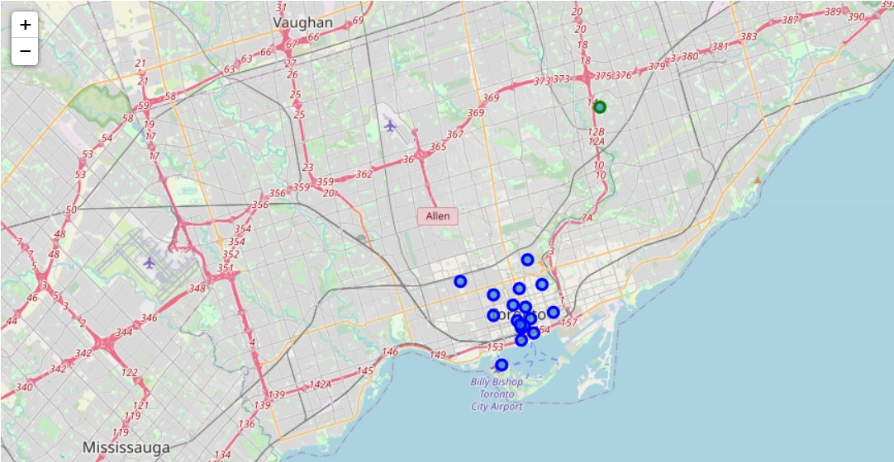
Visualizing the Map of Downtown Toronto
Blue markers would be added to show the neighborhoods in Downtown Toronto and a green marker to show Parkland neighborhood

Slide 5
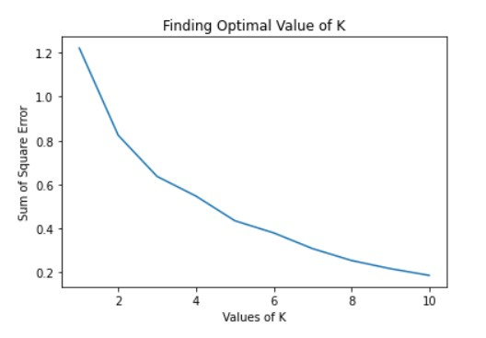
K-means Clustering
Finding the optimal value of k using elbow method

Slide 6
K-means Clustering
From the plot, the optimal value of k is 3.
So, we use K=3 for our k-means clustering.
Then the labels from the k-means clustering are merged to the data frame.
After merging the cluster label to the data frame, we check for the label of Parkwoods and then view all the neighborhoods containing similar labels
and also, the neighborhoods containing dissimilar labels.

Slide 7
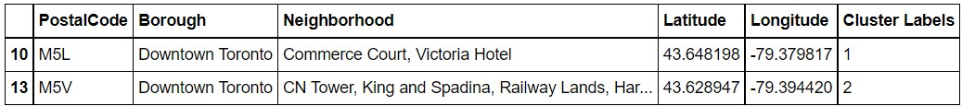
RESULT
Image showing the dissimilar neighborhoods:

Slide 8
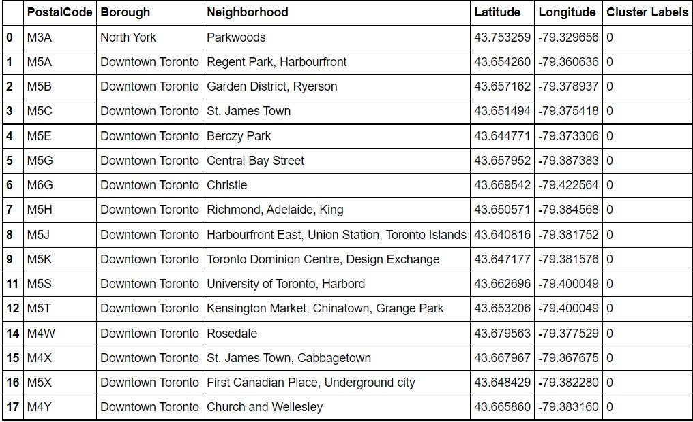
RESULT
Image showing the similar neighborhoods:

Slide 9
RESULT
Image showing the similar neighborhoods:

Slide 10
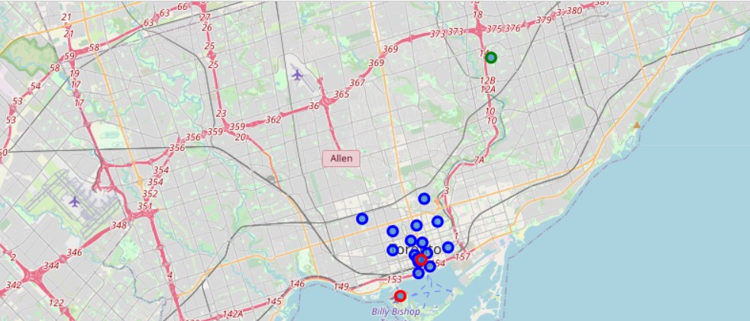
RESULT
Blue markers represent the similar neighborhoods in Downtown Toronto and the red marker represents dissimilar neighborhoods while the green marker represents Parkwoods neighborhood

Slide 11
Discussion & Conclusion
Based on the result, if one is moving from Parkwoods to Downtown Toronto and is curious to stay in a similar or dissimilar neighborhood from Parkwoods using Nearby venues as the criteria. Neighborhoods in Downtown Toronto are all similar to Parkwoods bar Commerce court, Victoria hotel, CN Tower, King and Spadina and Railway Lands.
Final decision should be made by stakeholders based on specific characteristics of neighborhoods and locations in every recommended zone, taking into consideration additional factors like attractiveness of each location, levels of noise / proximity to major roads, real estate availability, prices, social and economic dynamics of every neighborhood etc.

